Slide 1
GDP Growth And Employment
Chem 409 Jan. 15, 2015
Updated Jan. 12, 2017

Slide 2
What is GDP?
Investopedia
The gross domestic product (GDP) is one the primary indicators used to gauge the health of a country's economy. It represents the total dollar value of all goods and services produced over a specific time period - you can think of it as the size of the economy. Usually, GDP is expressed as a comparison to the previous quarter or year. For example, if the year-to-year GDP is up 3%, this is thought to mean that the economy has grown by 3% over the last year.

Slide 3
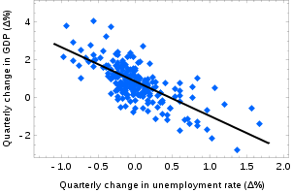
Why is GDP growth important?
Okun’s Law
In economics, Okun's law (named after Arthur Melvin Okun, who proposed the relationship in 1962^{[1]}) is an empirically observed relationship relating unemployment to losses in a country's production. The "gap version" states that for every 1% increase in the unemployment rate, a country's GDP will be roughly an additional 2% lower than its potential GDP.

Slide 4
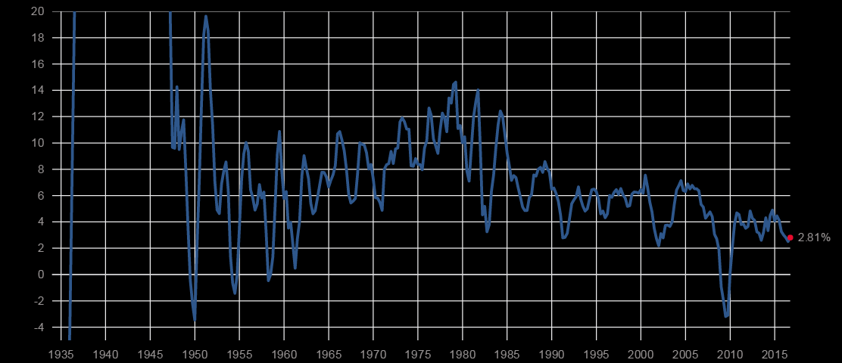
USA GDP Growth
http://www.multpl.com/us-gdp-growth-rate

Slide 5
US GDP growth for 2014
C&E News
In the U.S. in particular, growth was 1.8% in 2011 and 2.8% in 2012. IMF expects U.S. growth to total a meager 1.6% in 2013 and 2.6% next year.

Slide 6
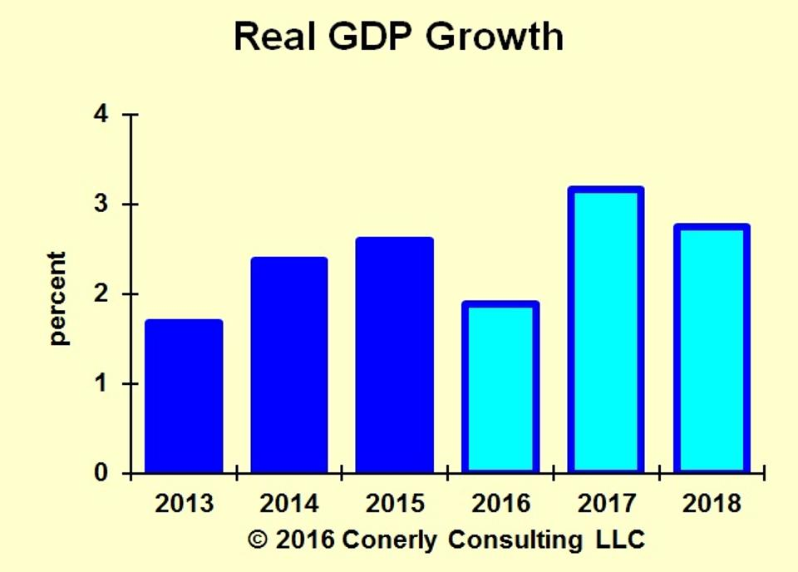
U.S. Economic Forecast 2017-2018
Forbes -- SEP 16, 2016 @ 09:22 AM

Slide 8
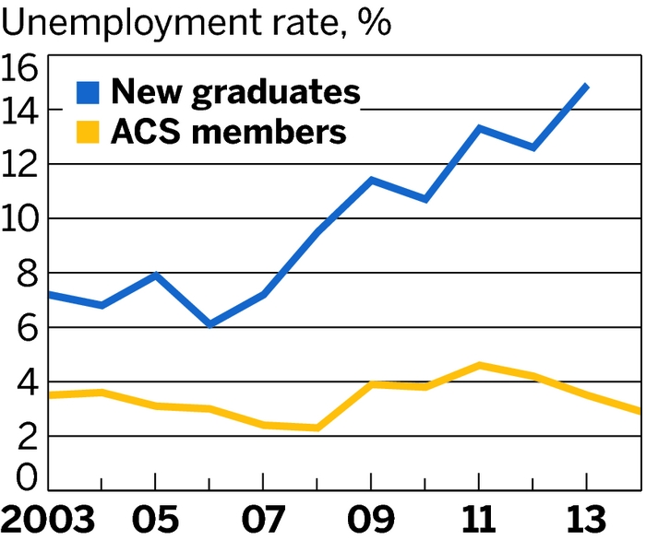
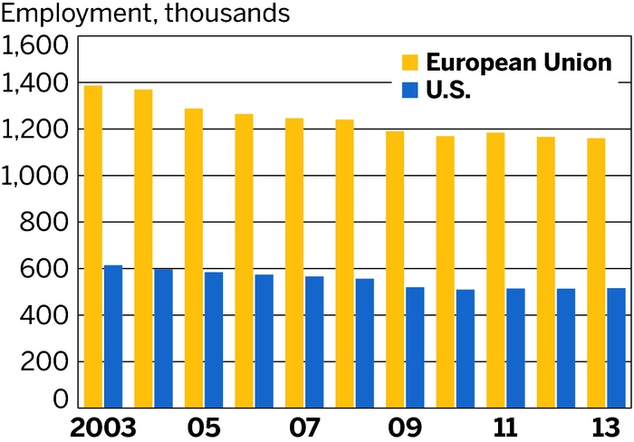
Unemployment rate for Chemists
C&E News

Slide 9
2016 Data
Volume 94 Issue 45 | pp. 28-29 Issue Date: November 14, 2016

Slide 10
Unemployment Rate by Major
Straighterline.com --- February 26, 2016
7 Majors With the Highest Employment Rates
Agriculture and Natural Resources - Recent College Graduate Unemployment: 4.5% / Experienced Grad: 3%
Physical Sciences - Recent College Graduate Unemployment: 5%/ Experienced Grad: 4.5%
Industrial Arts, Consumer Services, and Recreation - Recent College Graduate Unemployment: 5.4% / Experienced Grad: 4.4%
Health - Recent College Graduate Unemployment: 6.1% / Experienced Grad: 2.5%
Engineering - Recent College Graduate Unemployment: 6.5% / Experienced Grad: 3.5%
Business - Recent College Graduate Unemployment: 7% / Experienced Grad: 4.5%

Slide 11
7 Majors With the Highest Unemployment Rates
Architecture - Recent College Graduate Unemployment: 10% / Experienced Grad: 7.3%
Social Science - Recent College Graduate Unemployment: 10% / Experienced Grad: 5.4%
Arts - Recent College Graduate Unemployment: 9.5% / Experienced Grad: 6.7%
Psychology and Social Work - Recent College Graduate Unemployment: 9% / Experienced Grad: 6.1%
Law and Public Policy - Recent College Graduate Unemployment: 8.6% / Experienced Grad: 4.3%
Humanities and Liberal Arts - Recent College Graduate Unemployment: 8.4% / Experienced Grad: 5.8%
Computers, Statistics, and Math - Recent College Graduate Unemployment: 8.3% / Experienced Grad: 4.3%

Slide 12
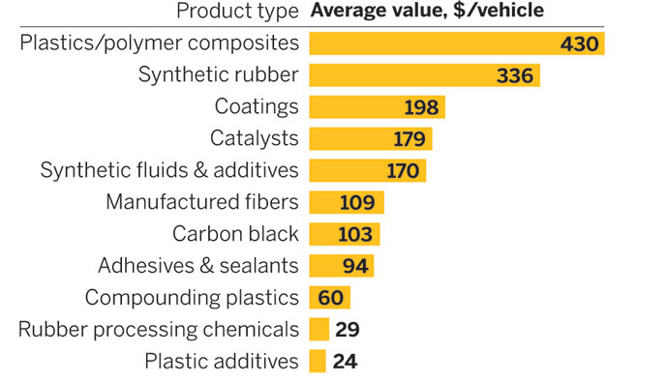
Chemical Industry Outlook 2017
http://cen.acs.org/articles/94/i2/Chemical-Outlook-2016-Region.html
The U.S. chemical industry faced plenty of economic headwinds in 2015. A strong dollar hampered exports. Trade partners Brazil, Japan, and Russia flirted with recession while growth in China slowed. Yet output increased by a healthy 3.8% last year, thanks in large part to consumers

Slide 13
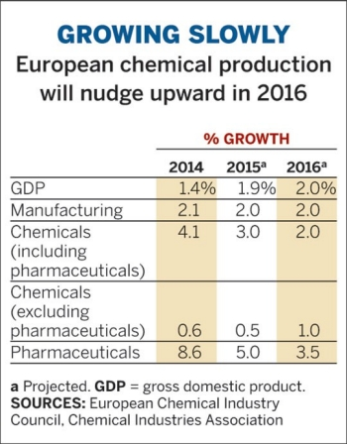
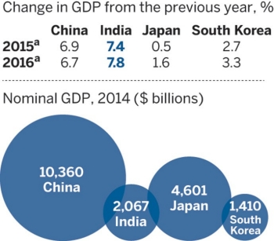

Slide 14
Conclusion
Things seem to be getting better

Slide 15
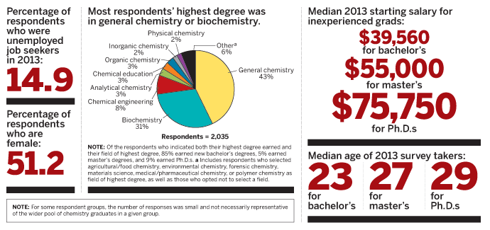
Starting Salaries
C&E News June 2, 2014

Slide 16
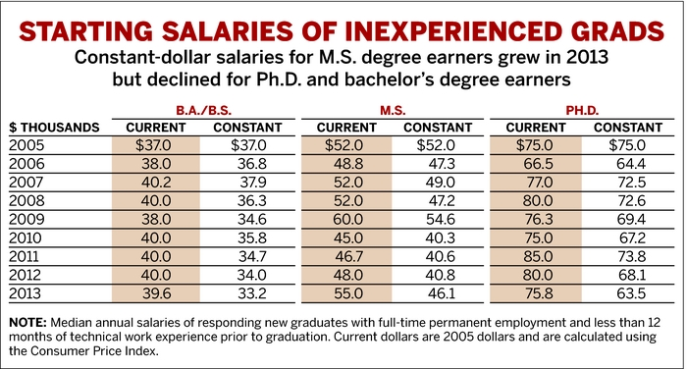

Slide 17
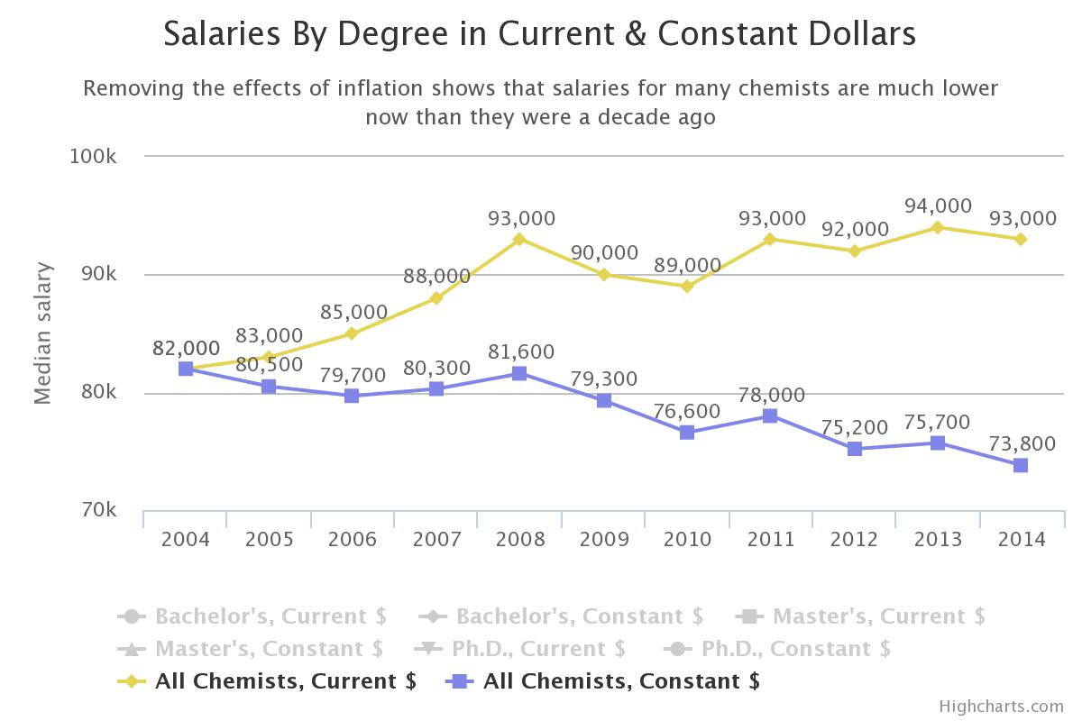
2014 Salaries & Employment C&E News Sept. 1, 2014

Slide 18
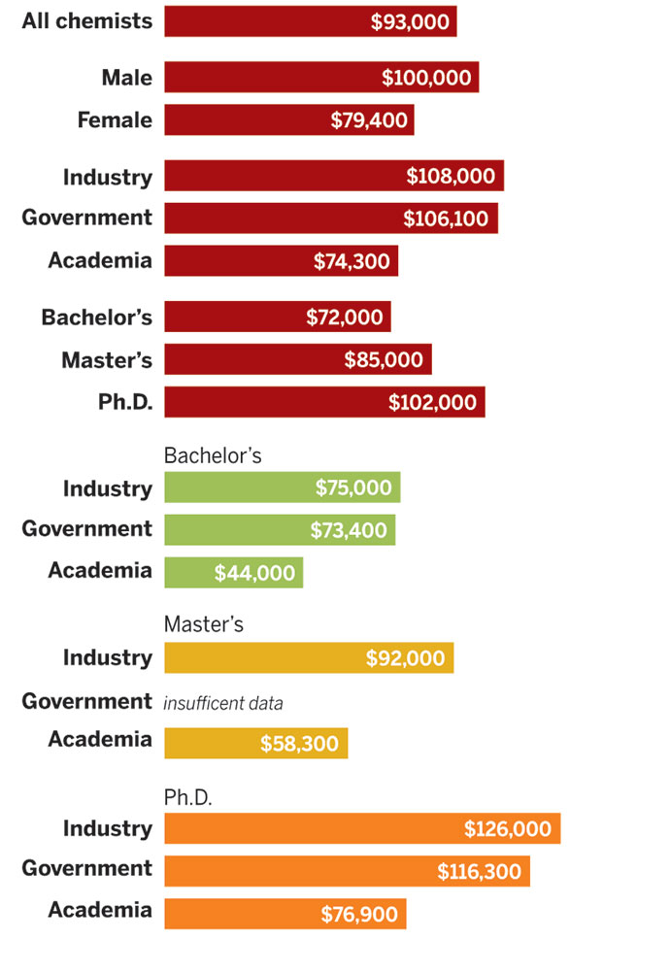
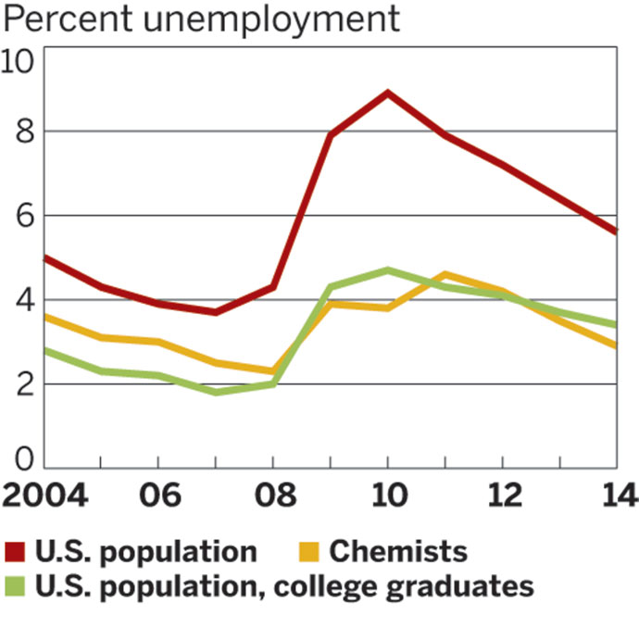

Slide 19
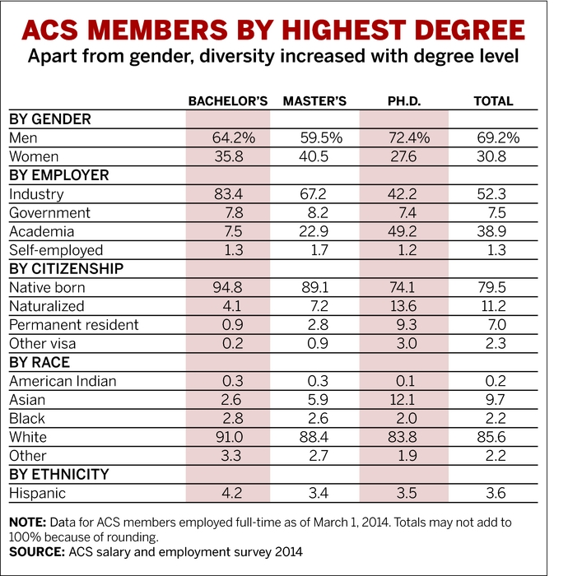
Most Chemist work in Industry

Slide 20
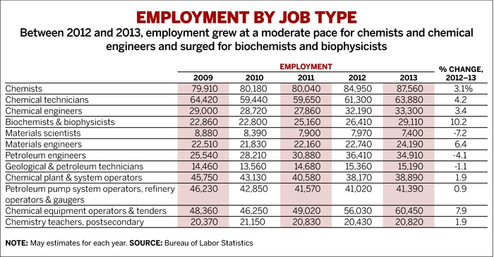

Slide 22
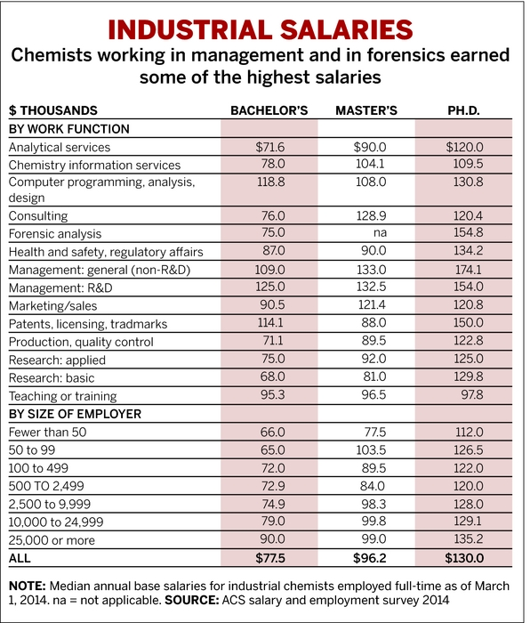

Slide 23
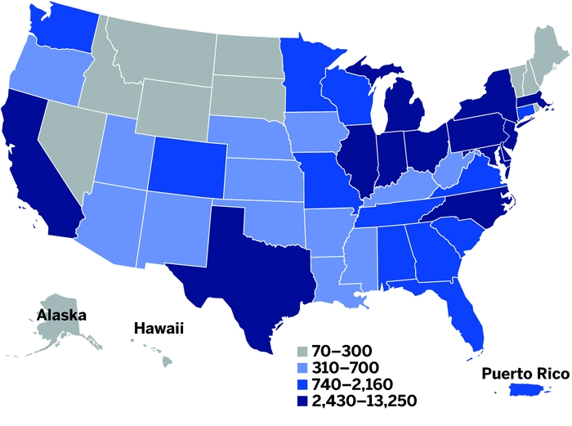
Demand For Chemists Up, Somewhat
C&E News Nov. 3, 2014
WHERE THE CHEMISTS ARE
California, Pennsylvania, New Jersey, Texas, and New York employ the most chemists. NOTE: Employment of chemists by state, May 2013. Ranges are defined by the Bureau of Labor Statistics and are not continuous. SOURCE: Bureau of Labor Statistics

Slide 24
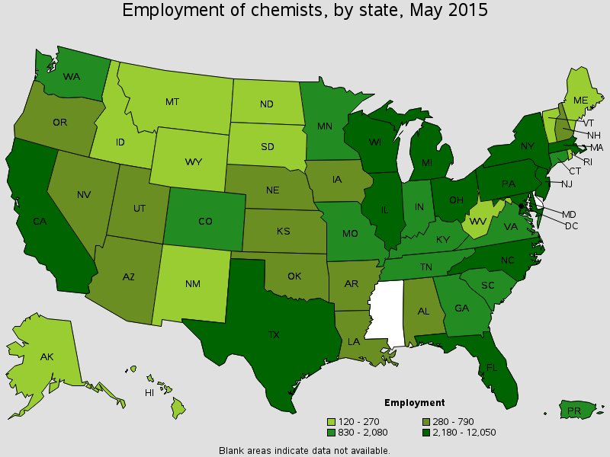
BLS Data

Slide 25
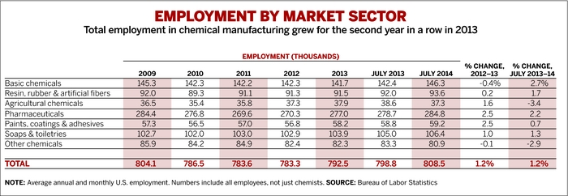

Slide 26
BLS 2016
Industry | Employment (1) | Percent of industry employment | Hourly mean wage | Annual mean wage (2)
Pharmaceutical and Medicine Manufacturing | 14,390 | 5.11 | $36.83 | $76,610
Scientific Research and Development Services | 13,890 | 2.15 | $43.33 | $90,130
Architectural, Engineering, and Related Services | 10,150 | 0.73 | $31.13 | $64,740
Federal Executive Branch (OES Designation) | 5,540 | 0.28 | $51.93 | $108,010
Basic Chemical Manufacturing | 4,870 | 3.28 | $35.86 | $74,600

Slide 27
“Talented and motivated chemists and chemical engineers who can adjust to this new normal and quickly find affordable solutions will be in high demand across the pharma and chemical industries, Hodges says. “We’re talking about a complete restructuring and remodeling of most businesses,” he predicts. While he expects employment to remain subdued in the short-term, in the medium- to long-term these trends mean there will be “no shortage of work for engineers and chemists.” “

