Slide 1
GUITAR – Graphene from the UI Thermolyzed Asphalt Reaction
The Scientific Method at Work
Chem 409, 2017

Slide 2
Scientific Method
Observation/Discovery
Hypothesis
Experiments
Conclusions
How is this done?
Is it this clean?

Slide 3
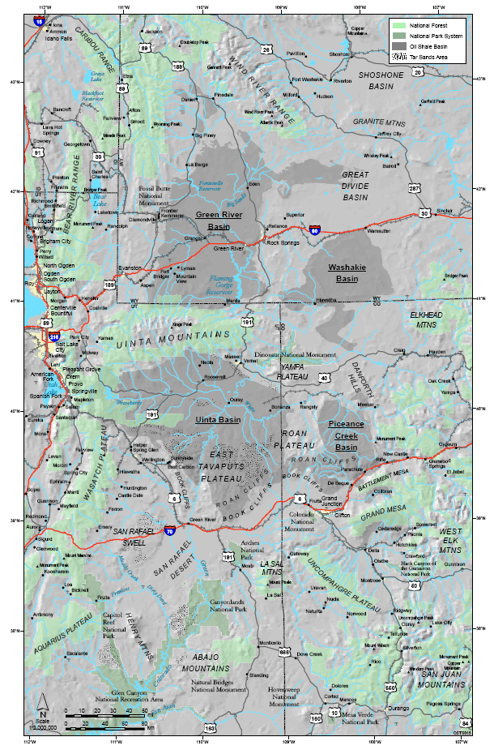
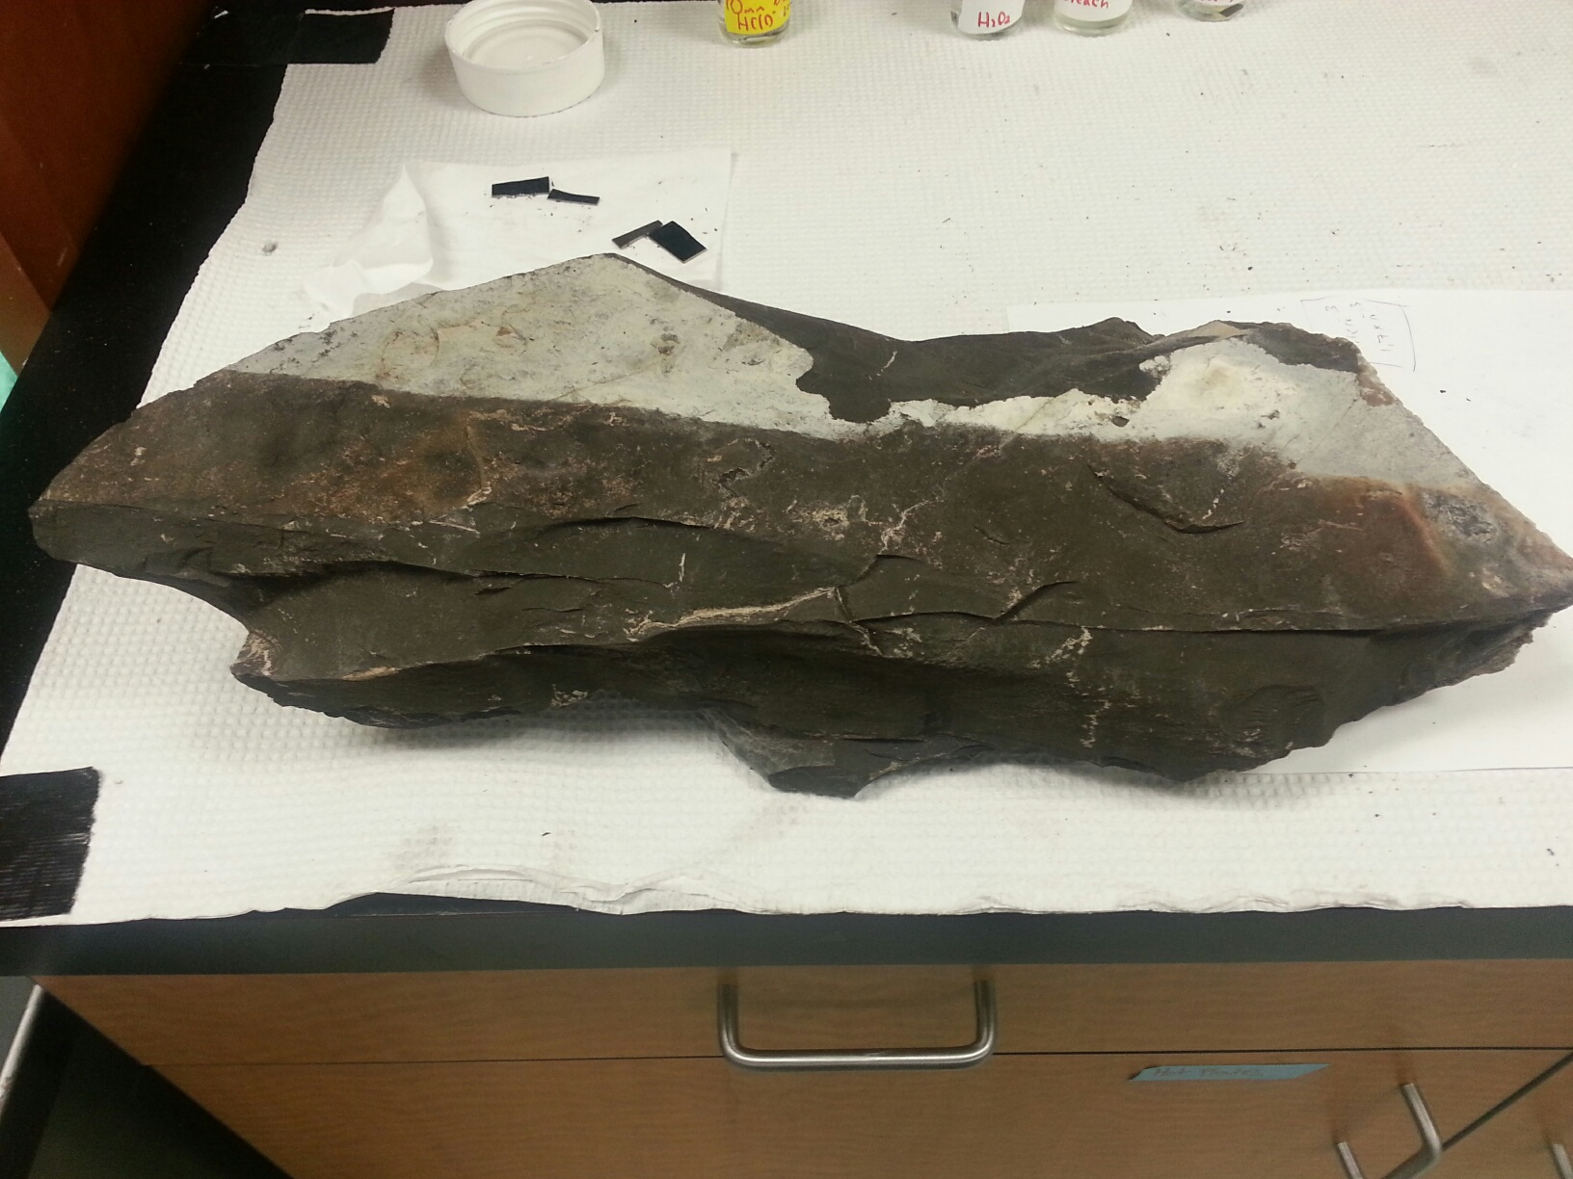
Discovery
Metals Analysis of Piceance Basin Oil Shale
Sample Pyrolyzed to Remove Organics
ID
WY
UT
Piceance Basin
CO

Slide 4
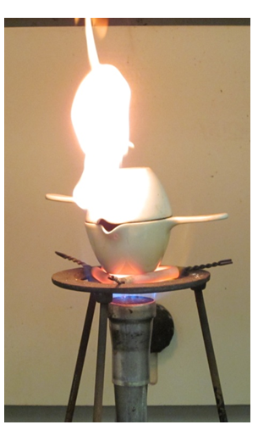
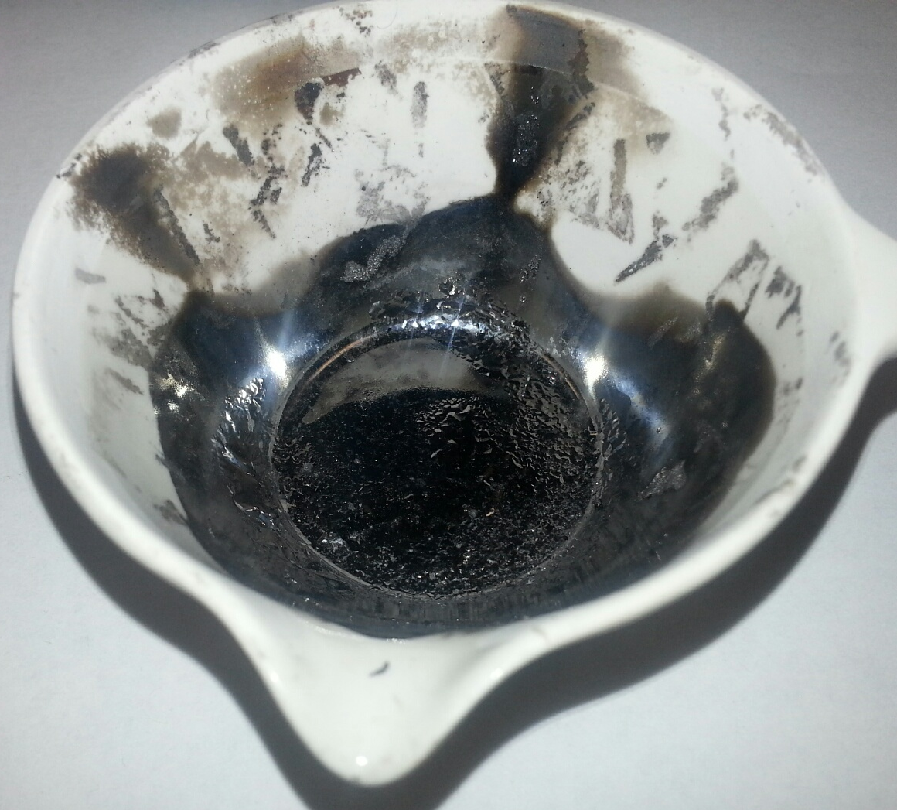
University of Idaho Thermolyzed Asphalt Reaction

Slide 5
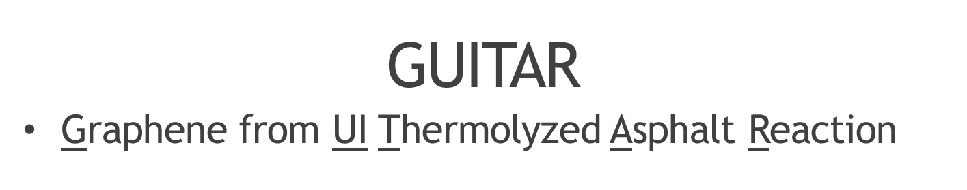
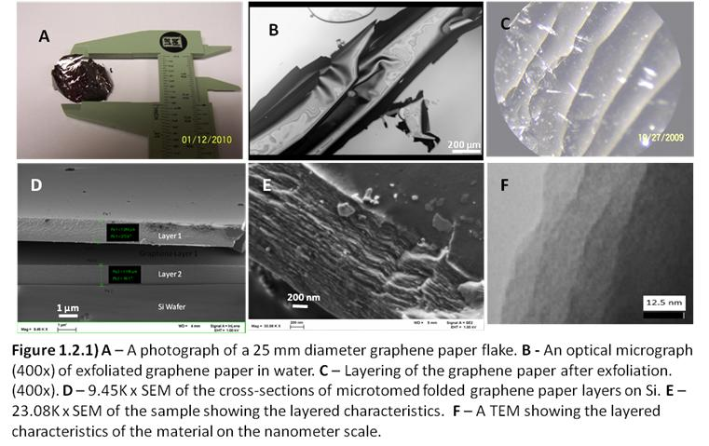

Slide 6
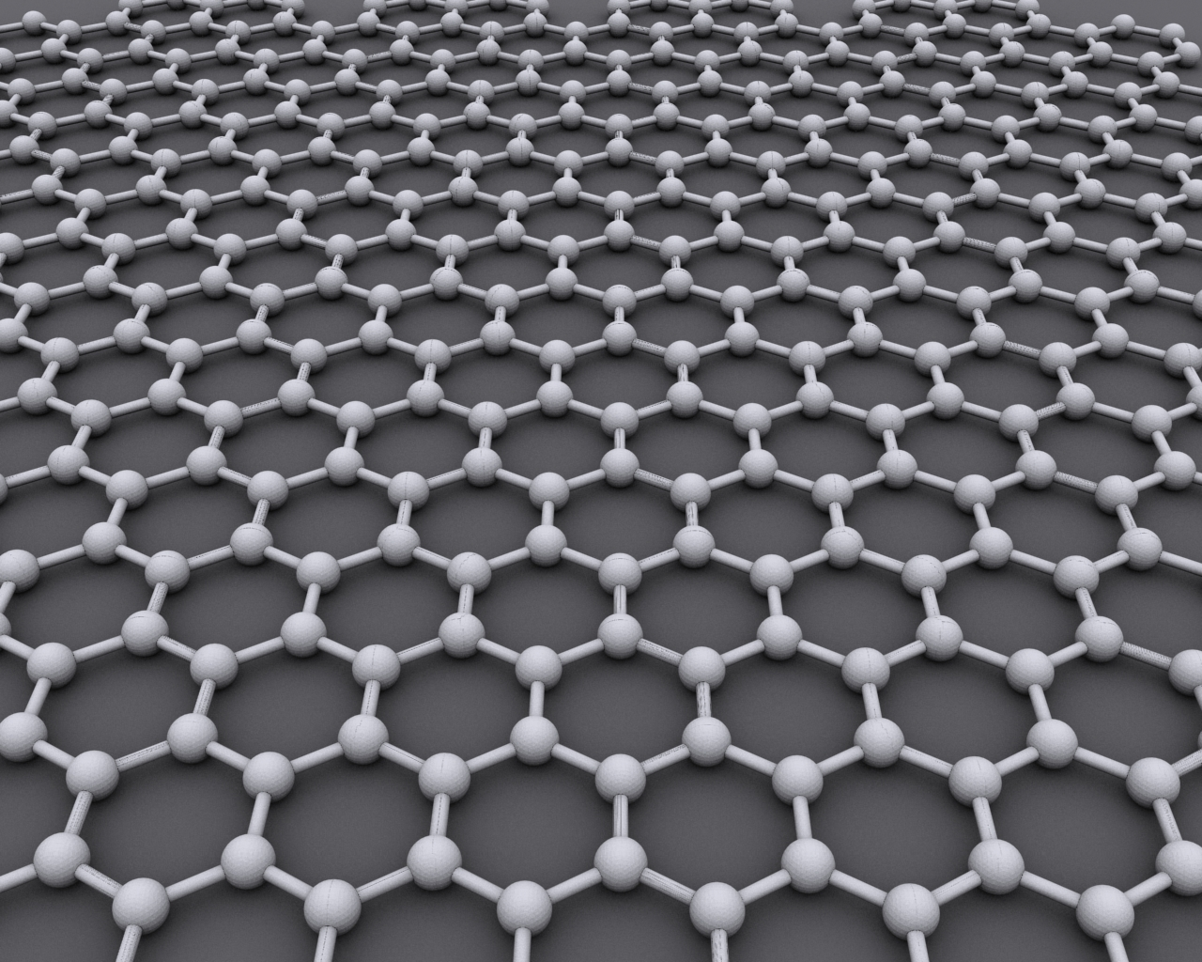
GUITAR and Graphites/Graphenes
sp² Carbon
Graphene
Source: Wikipedia

Slide 7
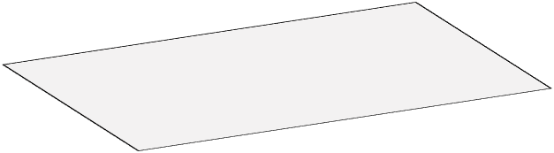
Morphology
  Basal Plane
  Edge Plane
Basal Plane
Edge Plane
Graphene
Graphite

Slide 8
Scientific Method
Observation/Discovery
Hypothesis
  It’s Graphene (or a very thin graphite)
  Graphene 2010 Nobel Prize in Physics
  Graphene is difficult to synthesize
Experiments
Conclusions

Slide 9
Scientific Method
Observation/Discovery
Hypothesis
Experiments
  Physical and Chemical Analyses (Characterization)
  Scanning Electron Microscopy
Conclusions

Slide 10
Physical Characterization
XPS
sp² Carbon
Intra-graphene
Stretches
Raman
Disordered
Graphite
IR
532 nm laser

Slide 11
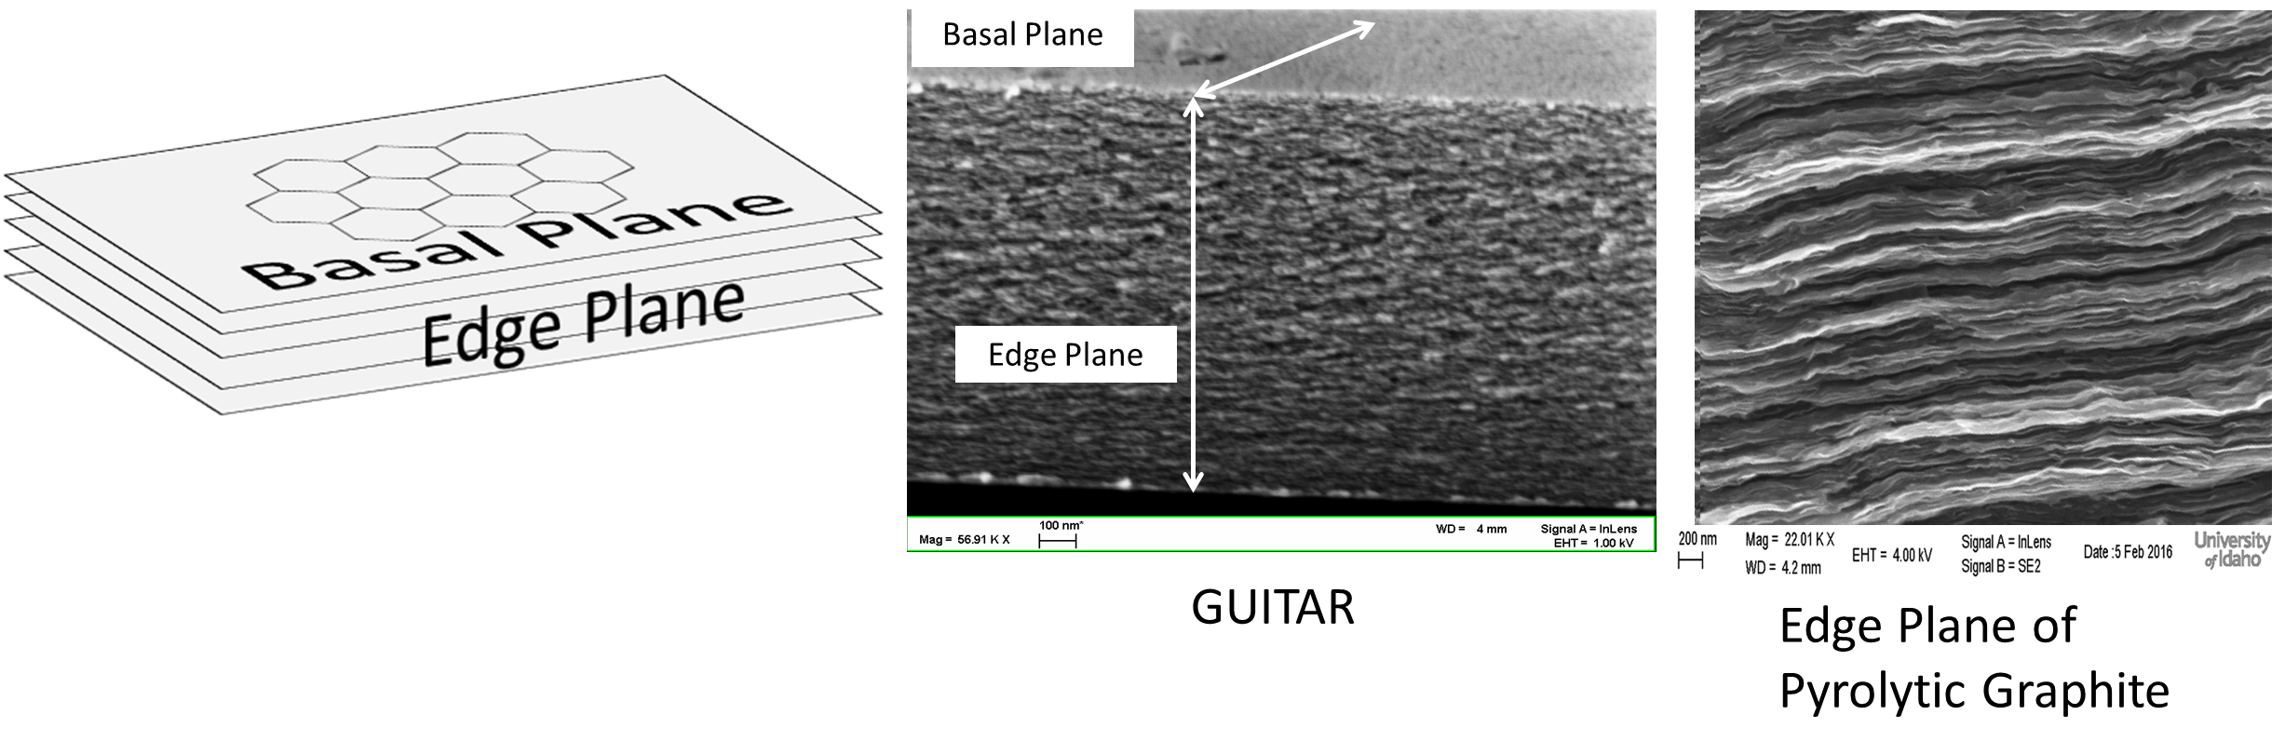
Scanning Electron Micrographs

Slide 12
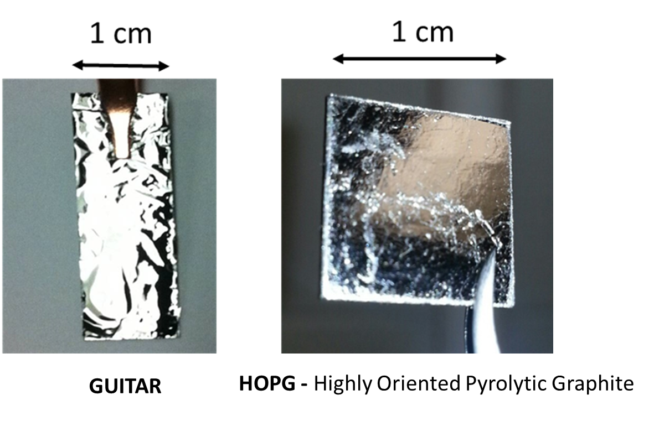
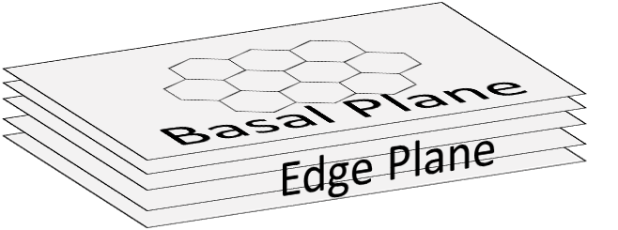
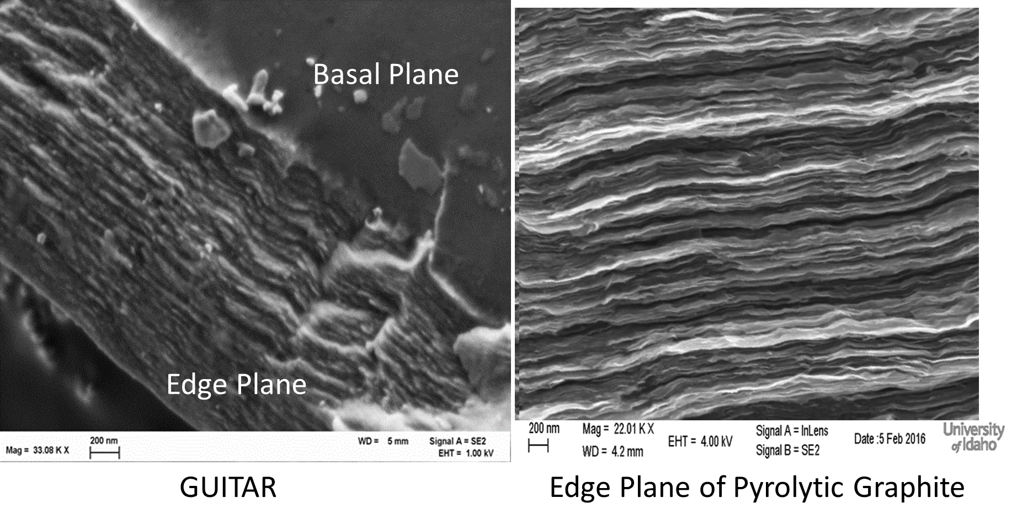
Photographs of Basal Planes
Scanning Electron Micrographs

Slide 13
Physical Characterization
 | Graphite/Graphene | GUITAR | Other Notes
XPS | sp² carbon | sp² carbon | Similar
Raman | Crystalline | Nanocrystalline | GUITAR may be disordered graphene
Microscopy -Optical -Electron | Layers | Layers | Similar

Slide 14
Scientific Method
Observation/Discovery
Hypothesis
Experiments
Conclusions
  It’s Graphene!
  Publication
  Patent w/UI

Slide 15
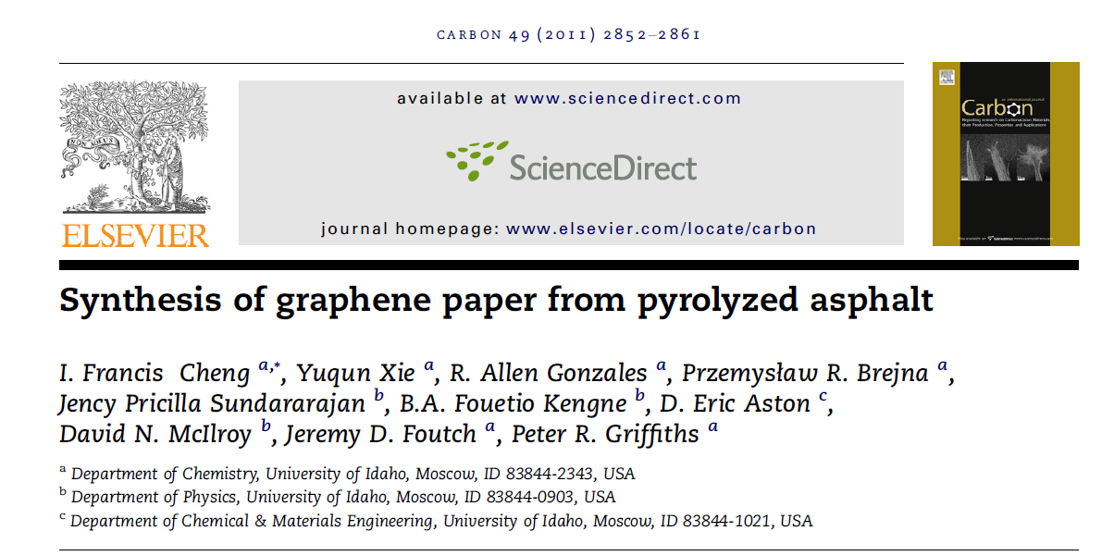
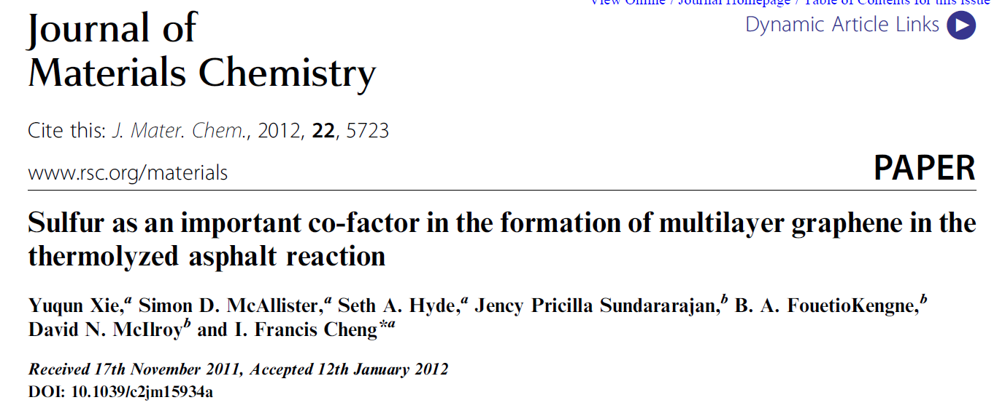

Slide 16
What Next?
GUITAR = Graphene (or a very thin graphite)
Graphene hypothesized to have extraordinary properties
Let’s Make Electrodes Out of GUITAR.

Slide 17
Measure Rates of Electron Transfer
Why?
Batteries
Fuel Cells
Solar Cells
Sensors
Ultracapacitors
Anodic Water Purification
GUITAR Electrode
Ox
Aqueous
Solution
e⁻
Red

Slide 18
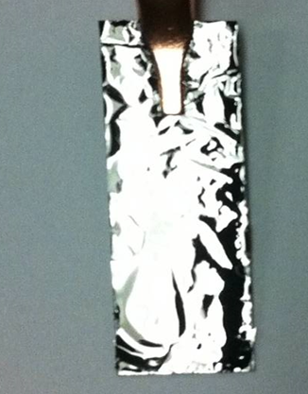
GUITAR Electrode

Slide 19
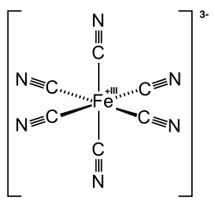
Redox Probes
Fe(CN)₆³⁻ + e⁻ ⇄ Fe(CN)₆⁴⁻
Ru(NH₃)₆³⁺ + e⁻ ⇄ Ru(NH₃)₆²⁺
k⁰
Source: Wikipedia
k⁰

Slide 20

3-
(Ox)
GUITAR Electrode
Aqueous Solution
e⁻
4-
(Red)

Slide 21
k⁰ obtained from Cyclic Voltammetry
k⁰ cm/s | Fe(CN)₆ ^{3-/4-} | Ru(NH₃)₆ ^{3+/2+}
GUITAR | 1.2 × 10⁻² | 1.7 × 10⁻²
Conclusion: GUITAR has fast heterogeneous electron transfer

Slide 22
What Next?
Publish in Literature
  Graphene is great stuff
Better Read What’s Going On in Literature

Slide 23
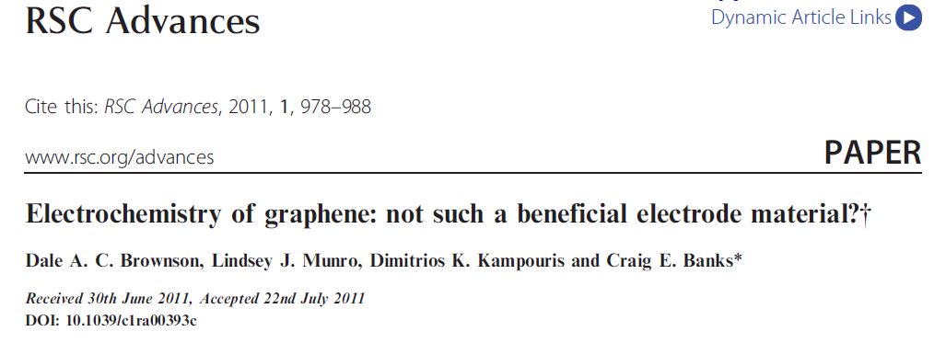
HOPG, McCreery, Anal. Chem. 1992, 64, 2518-2524

Slide 24
Density of Electronic States
McCreery et al, J. Phys. Chem. 1994, 98, 5314-5319
E_{Fermi}
E_{Fermi}
Valence
Band
Conduction
Band
DOS
σ+
π+
π-
σ-
Energy (eV)
Crystalline Graphite
Disordered Graphite

Slide 25
e- Transfer Rates Edge vs. Basal Planes
Electron transfer rates on HOPG, graphites and graphenes
  Anisotropic Behavior
  Edge Plane >> Basal Plane
Red
Ox + ne⁻
slow
McCreery et al, J. Phys. Chem. 1994, 98, 5314-5319
Basal
Fast
Edge
Ox + ne⁻
Red

Slide 26
Step Defects
Step Defect
Fast e⁻ transfer too
Red
Ox + ne⁻
Fast
Basal Plane
Edge Plane

Slide 27
k⁰ obtained from Cyclic Voltammetry
k⁰ cm/s | Fe(CN)₆ ^{3-/4-} | Ru(NH₃)₆ ^{3+/2+}
BP-GUITAR | 1.2 × 10⁻² | 1.7 × 10⁻² | This work
EP-GUITAR | 3 × 10⁻² | --
Basal Plane Materials
BP-Graphene | ≤ 10⁻⁹ | ≤ 10⁻³ | Literature
BP-HOPG | ≤ 10⁻⁶
BP-Graphite | ≤ 10⁻³
Edge Plane Materials
EP-Graphene | ≤ 10⁻² | -- | Literature
EP-HOPG |  | ≤ 10⁻¹
EP-Graphite |  | ≤ 10⁻²
Glassy Carbon |  | ≤ 10⁻²
No Anisotropy
EP = BP
Anisotropy
EP >> BP

Slide 28
Scientific Method
Observation/Discovery
Hypothesis
Experiments
Conclusions
  It’s Graphene!
  Publication
  Patent w/UI

Slide 29
Scientific Method
Observation/Discovery
  GUITAR has fast e- transfer
    Basal Plane = Edge Plane
  Graphene and Graphites (1990’s to 2011)
    Edge Plane >> Basal Plane
Hypothesis
Experiments
Conclusions
(glad I didn’t publish so quickly)

Slide 30
Scientific Method
Observation/Discovery
  What Else is Different About GUITAR?
Hypothesis
Experiments
Conclusions

Slide 31
Electrochemical Window
Anodic Limit
  Water breakdown
    2H₂O → O₂ + 4H⁺ + 4e- E⁰ = 1.23 volts
  Corrosion
    C + 2H₂O → CO₂ + 4H⁺ + 4e- E⁰ = 0.207 V
Cathodic Limit
  Water breakdown
    4H⁺ + 4e⁻ → 2H₂ E⁰ = 0.00 volts

Slide 32
Current
1 M strong acid
Oxygen overpotential
2H₂O → O₂ + 4H⁺ + 4e-
Hydrogen
overpotential
No reaction
0 V
1.23 V
More oxidizing
4H⁺ + 4e⁻ → 2H₂
E, potential (Volts)

Slide 33
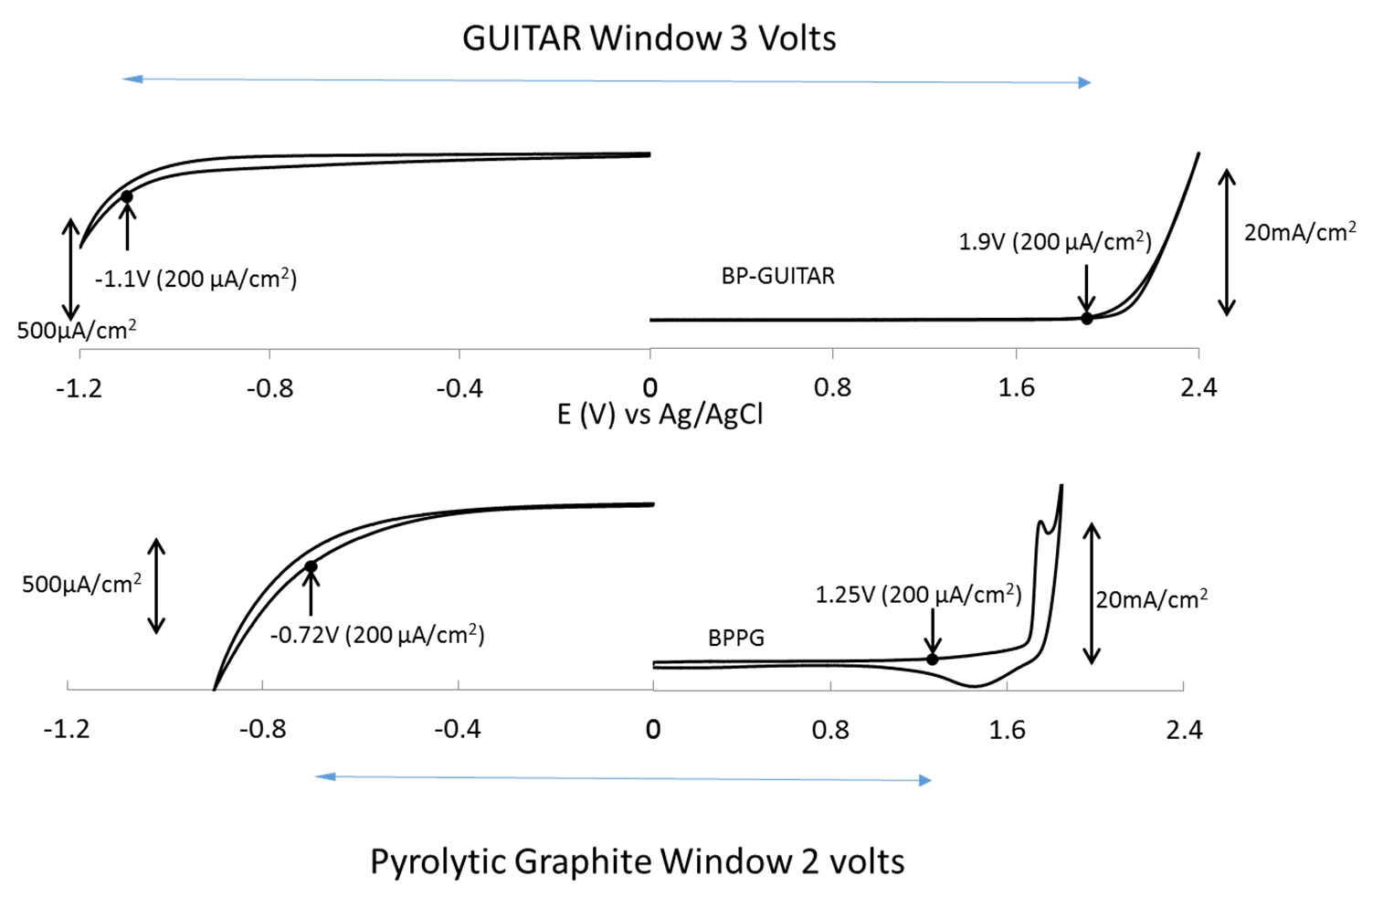
Potential Windows in 1 M H₂SO₄

Slide 34
Summary Potential Windows in 1 M H₂SO₄
Material | Current Limits (µA/cm²) | Cathodic limits (V) | Anodic limits (V) | Total Windows (V) | Reference
GUITAR | 200 | -0.9 | 2.1 | 3 | This work
Graphites | 200 | -0.4 to -0.5 | 1.4 to 1.9 | 2 | This work & Literature
Boron Doped Diamond Diamond-Like Carbon Amorphous Carbons | 200 – 300 | -0.4 to -1.25 | 1.7 to 2.4 | 3 | Literature

Slide 35
Observations
GUITAR has resistance to corrosion
  GUITAR = Synthetic Diamonds ($$)
  GUITAR > Graphene or Graphite
  GUITAR is sp² carbon
  Diamonds are sp³

Slide 36
Scientific Method
Observation/Discovery
  What Else is Different About GUITAR?
  GUITAR has fast e- transfer
    Basal Plane = Edge Plane
  Resistance to Corrosion > Graphene/Graphite
Hypothesis
  GUITAR is not Graphene or Graphite!
Experiments
Conclusions

Slide 37
Scientific Method
Observation/Discovery
Hypothesis
  GUITAR is not Graphene or Graphite!
  New Allotrope?
Experiments
Conclusions

Slide 38
Scientific Method
Observation/Discovery
  What Else is Different About GUITAR?
  Resistance to Corrosion > Graphene/Graphite
Hypothesis
  GUITAR is not Graphene or Graphite!
  New Allotrope?
  Why is GUITAR Resistant to Corrosion?
Experiments
Conclusions

Slide 39
Potential Windows in 1 M H₂SO₄

Slide 40
Blister formation on graphitic anodes
Grain
Boundary
CO₂(g) + O₂(g)
HSO₄⁻
Step Defect
HSO₄⁻
Electrolyte Intercalation
Gas Evolution
Blister Formation
Pit Corrosion
Diagnostic from Cyclic Voltammetric Sweeps
Electrolyte inter- and de-intercalation
  [C_{x}] + [HSO₄⁻] + y H₂O ⇄ [C_{x}⁺ HSO₄⁻]y(H₂O) + e⁻
Murray et al, Analytical Chemistry, 1995, 67, 2201-2206

Slide 41
Grain
Boundary
CO₂(g) + O₂(g)
HSO₄⁻
Step Defect
HSO₄⁻
+ + +
HSO₄⁻
HSO₄⁻
HSO₄⁻
HSO₄⁻
HSO₄⁻
HSO₄⁻
HSO₄⁻
HSO₄⁻
HSO₄⁻
+ + + + + +

Slide 42
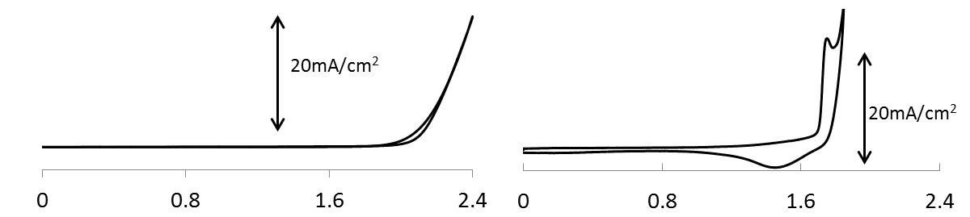
GUITAR Lacks Voltammetric Evidence for Electrolyte Intercalation
GUITAR
Pyrolytic Graphite
Intercalation peak current
1 M H₂SO₄
Zero De-intercalation current
Potential vs. Ag/AgCl
De-intercalation peak current
    [C_{x}⁺ HSO₄⁻]y(H₂O) + e⁻ → [C_{x}] + [HSO₄⁻] + y H₂O

Slide 43
What about edge plane intercalation?
HSO₄⁻
Electrolyte Intercalation
Edge plane
Electrodes
335 pm

Slide 44
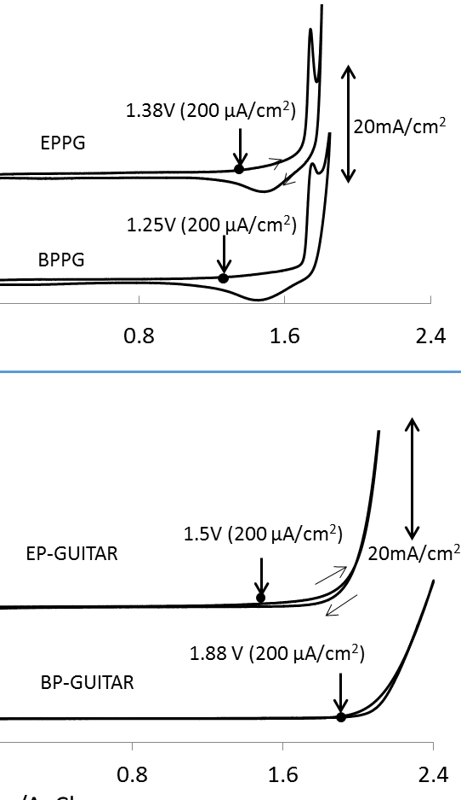
Edge Plane Graphite
Edge Plane GUITAR

Slide 45

Observations
Graphite
GUITAR
Grain
Boundary
CO₂(g) + O₂(g)
HSO₄⁻
Step Defect
HSO₄⁻
Impervious to Intercalation

Slide 46
Scientific Method
Observation/Discovery
  GUITAR does not allow for electrolyte intercalation
Hypothesis
  ?
Experiments
Conclusions

Slide 47
Scientific Method
Observation/Discovery
  Collect More Observations
Hypothesis
  ?
Experiments
Conclusions

Slide 48
Photographs of Basal Planes
Graphite Morphology
Scanning Electron Micrographs

Slide 49
What’s Going on at The Basal Planes?
What’s so different about GUITAR’s basal planes?
  Disordered Graphite?
Went back at looked old scanning electron micrographs.

Slide 50
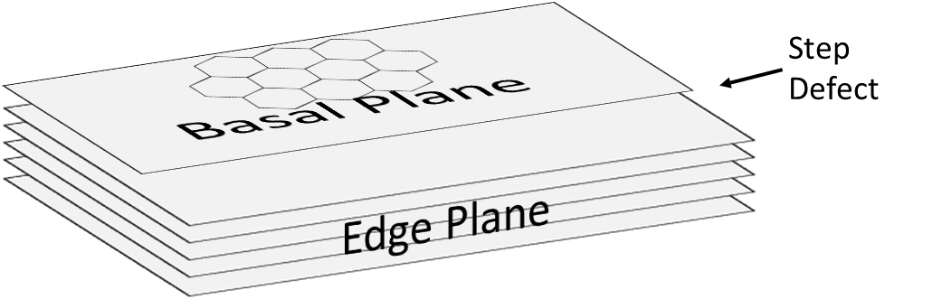
GUITAR and Graphites/Graphenes
Shared Morphology
Basal Plane
Edge Plane
  Step Defects?
    Not Observed on GUITAR
GUITAR

Slide 51
GUITAR Lacks Steps Defects
GUITAR – Lacks Step Defects
HOPG – Step Defects

Slide 52
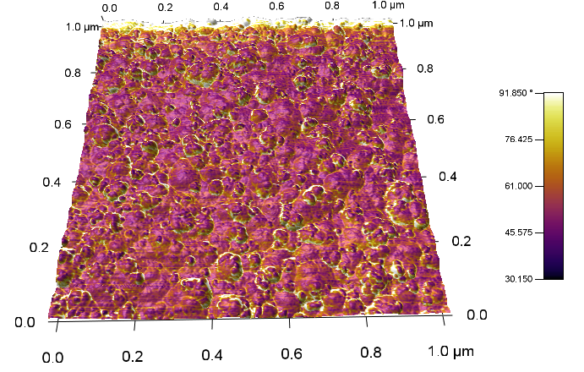
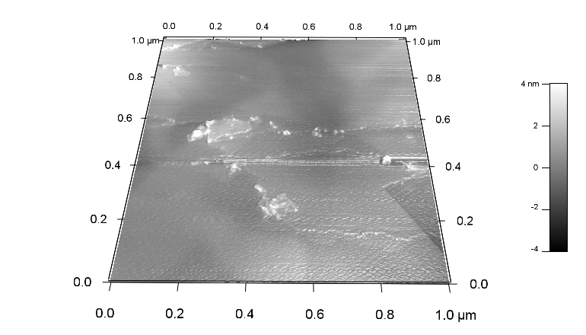
GUITAR
Graphite (HOPG)
Line Section
AFM Asylum Research – Spring 2016 ACS Meeting San Diego – On Quartz

Slide 53
AFM Studies of Basal Planes
GUITAR
  Lacks Step Defects
  Rougher Surfaces 10-50 nm Amplitudes
HOPG
  Relatively Flat, 2-4 nm Amplitudes
  Clear Step Defects

Slide 54
Scientific Method
Observation/Discovery
  Collect More Observations
  AFM and SEM indicate no Step Defects
Hypothesis
  GUITAR is a new allotrope of Carbon
  Atomic Arrangement?
Experiments
Conclusions

Slide 55
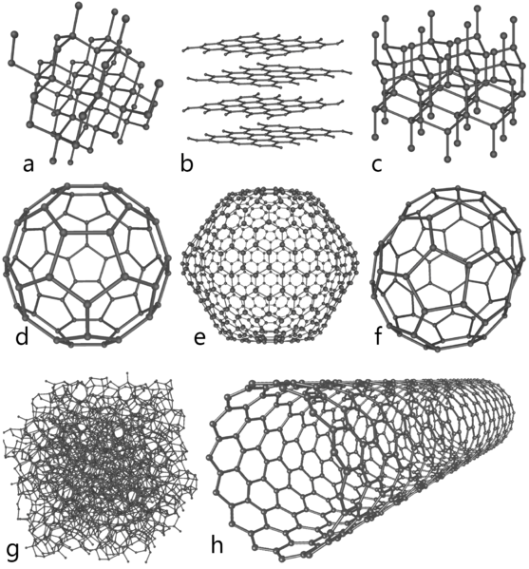
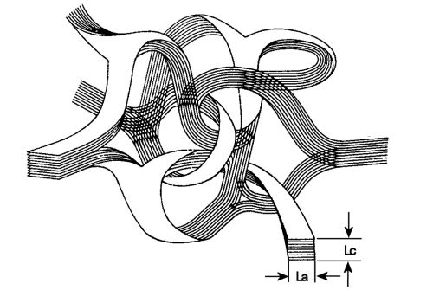
GUITAR – Which Allotrope?
Graphite
Lonsdaleite
1968
Diamond
Fullerenes, 1996
Nobel Prize
Curl, Kroto, Smalley
Carbon nanotubes
1991
Glassy Carbon
Amorphous carbon
http://en.wikipedia.org/wiki/Carbon

Slide 56
Scientific Method
Observation/Discovery
Hypothesis
  GUITAR is a new allotrope of Carbon
Experiments
  Raman Spectroscopy w/ Boise State
  X-ray Diffraction w/ Texas A&M
Conclusions
  ?

Slide 57
Scientific Method
Observation/Discovery
Hypothesis
Experiments
Conclusions
How is this done?

Slide 58
What is it Good For?
GUITAR Applications
  Sensors (w/ Industry)
  Fuel Cells
    One of the Highest Performers
  Batteries
    Redox Flow – One of the Highest Performers (Published)
  Water Purification
    Anodic Purification (in place of diamond ($$))
    Desalinization
  Chromatography
    New Station Phases

