Slide 1
GDP Growth And Employment
Chem 409 January 15, 2015

Slide 2
What is GDP?
Investopedia
The gross domestic product (GDP) is one the primary indicators used to gauge the health of a country's economy. It represents the total dollar value of all goods and services produced over a specific time period - you can think of it as the size of the economy. Usually, GDP is expressed as a comparison to the previous quarter or year. For example, if the year-to-year GDP is up 3%, this is thought to mean that the economy has grown by 3% over the last year.

Slide 3
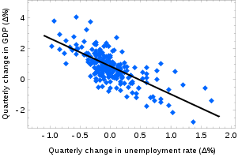
Why is GDP growth important?
Okun’s Law
In economics, Okun's law (named after Arthur Melvin Okun, who proposed the relationship in 1962^{[1]}) is an empirically observed relationship relating unemployment to losses in a country's production. The "gap version" states that for every 1% increase in the unemployment rate, a country's GDP will be roughly an additional 2% lower than its potential GDP.

Slide 4
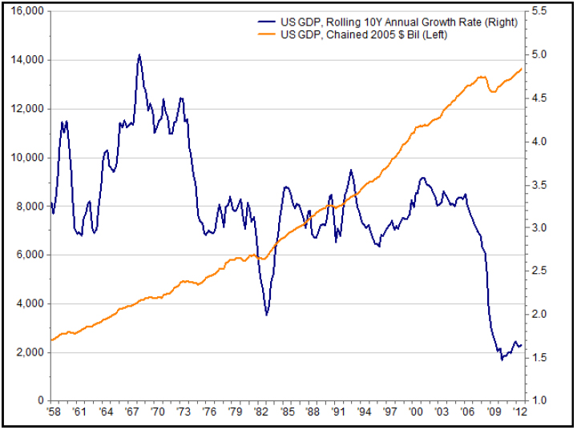
USA GDP Growth
https://www.nb.com/wealth/spotlight/Ahead_for_US_Growth/

Slide 5
US GDP growth for 2014
C&E News
In the U.S. in particular, growth was 1.8% in 2011 and 2.8% in 2012. IMF expects U.S. growth to total a meager 1.6% in 2013 and 2.6% next year.

Slide 6
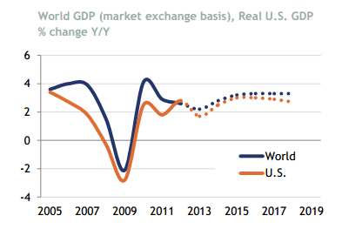
UN Predictions
CHEManager International
Link

Slide 8
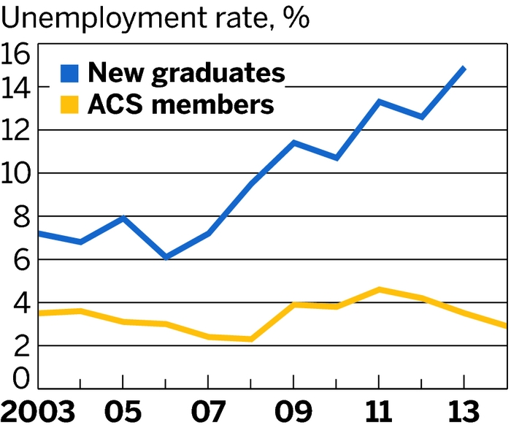
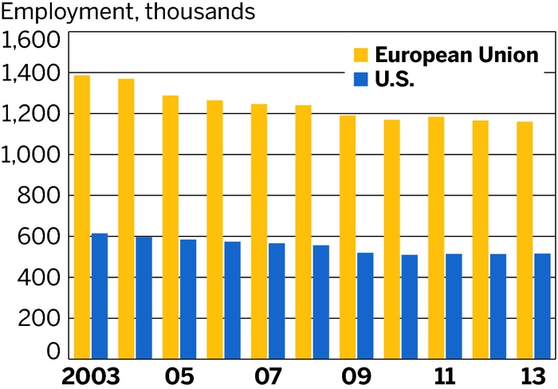
Unemployment rate for Chemists
C&E News

Slide 9
Unemployment Rate by Major (2014)
Studentsreview.com
Chemistry 4.4 % (B.S., M.S. Ph.D.)
Chemical Engineering 2.9%
Electrical Engineering 3.8%
Civil Engineering 12.9%
Economics 4.4%
Finance 6.4%

Slide 10
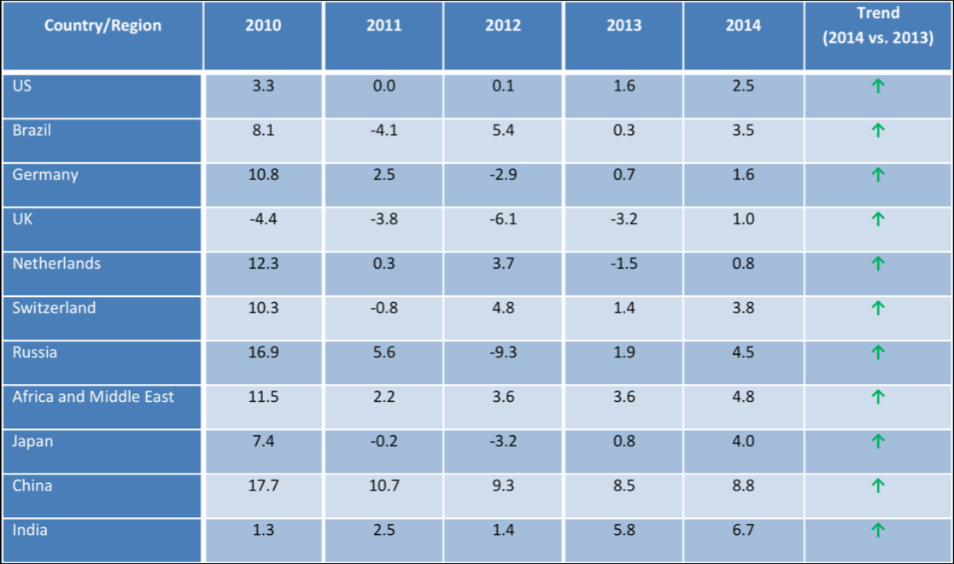
Chemical Industry Outlook for 2014
http://www.thesmartcube.com/insights/blog/blog-details/insights/2014/01/09/chemical-industry-outlook-2014-poised-for-growth-structural-realignment-to-continue

Slide 11
Conclusion
Things could be worse

Slide 12
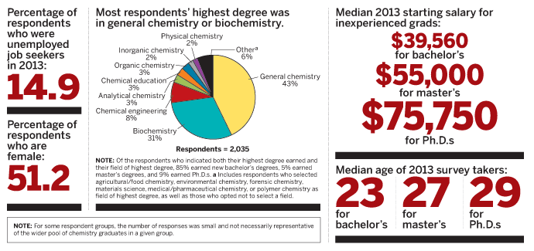
Starting Salaries
C&E News June 2, 2014

Slide 13
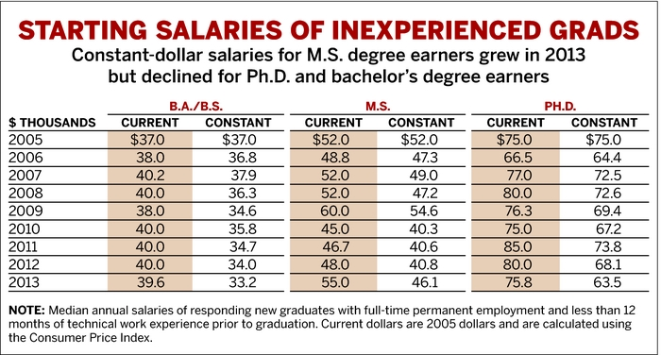

Slide 14
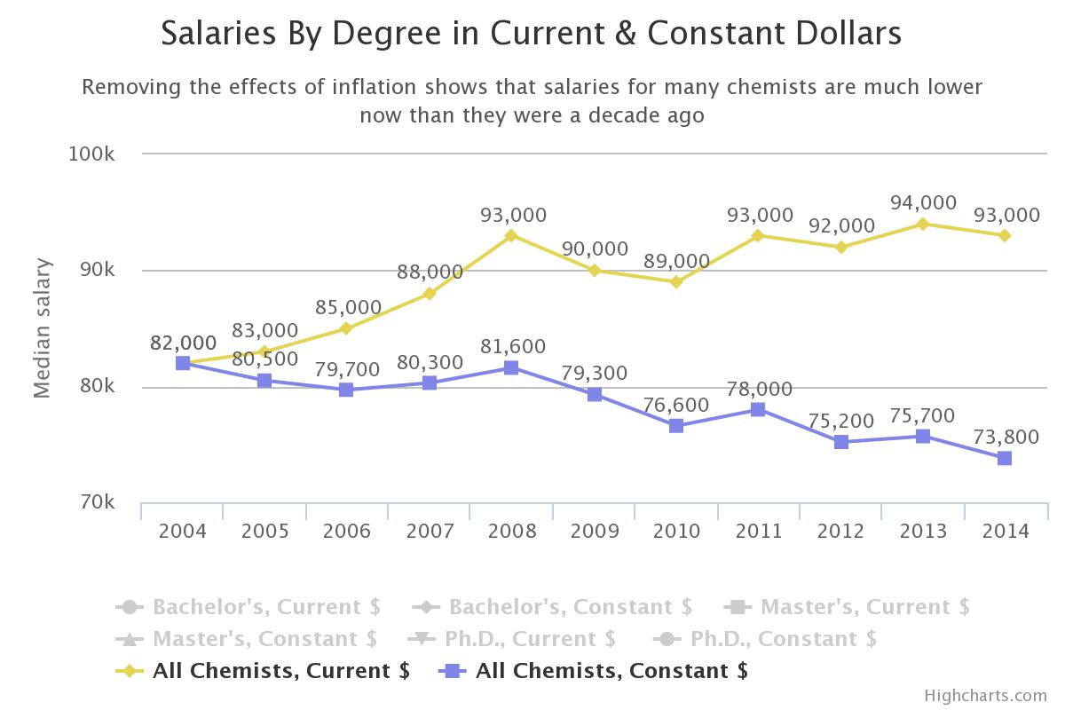
2014 Salaries & Employment C&E News Sept. 1, 2014

Slide 15
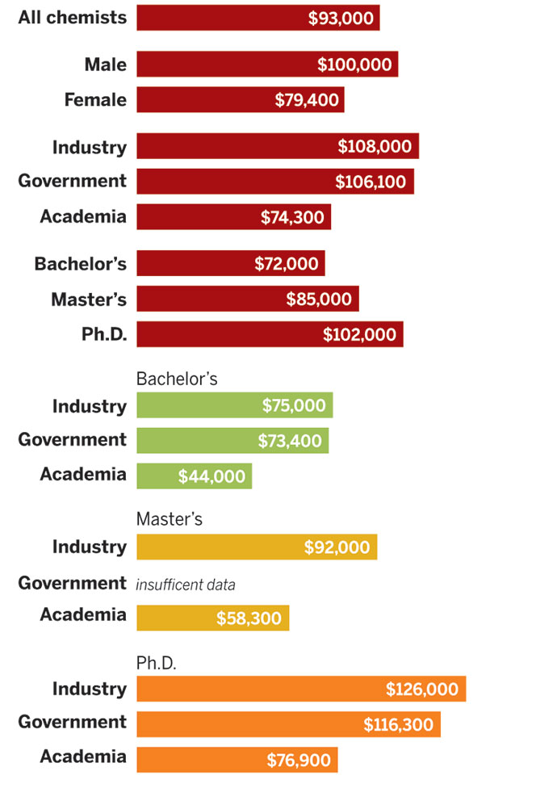
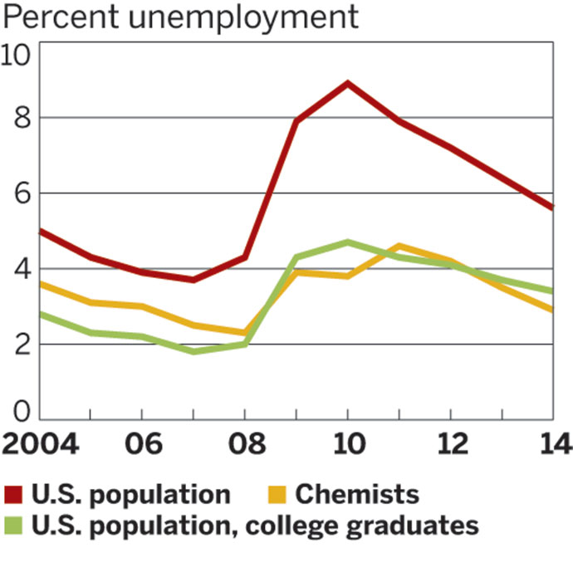

Slide 16
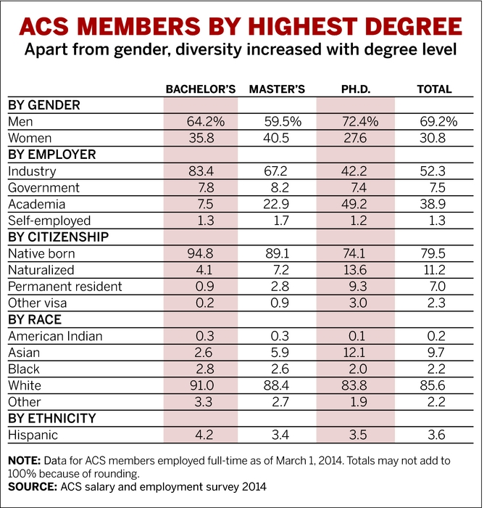
Most Chemist work in Industry

Slide 17
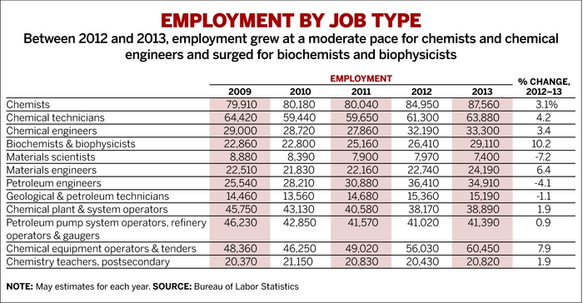

Slide 19
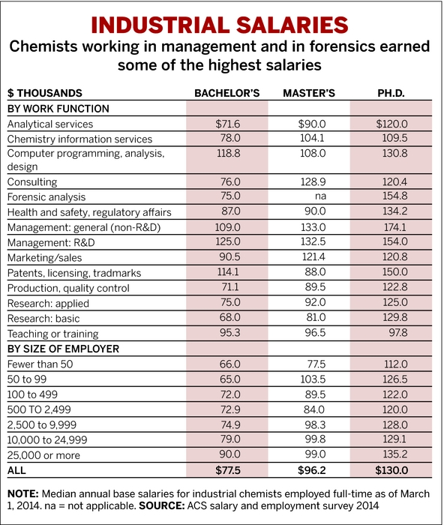

Slide 20
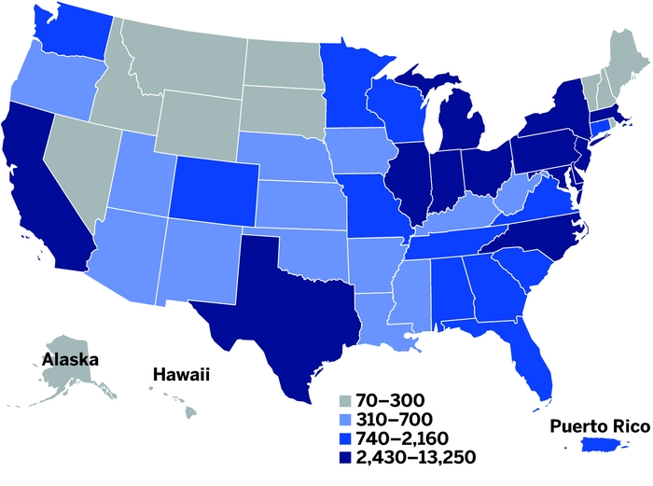
Demand For Chemists Up, Somewhat
C&E News Nov. 3, 2014
WHERE THE CHEMISTS ARE
California, Pennsylvania, New Jersey, Texas, and New York employ the most chemists. NOTE: Employment of chemists by state, May 2013. Ranges are defined by the Bureau of Labor Statistics and are not continuous. SOURCE: Bureau of Labor Statistics

Slide 21
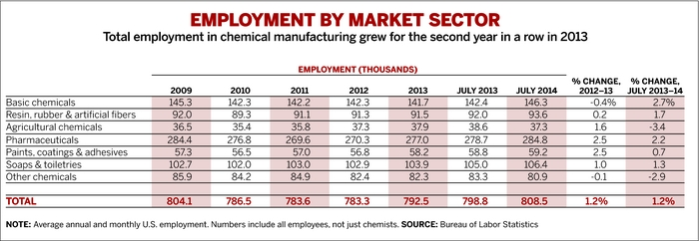

Slide 22
“Talented and motivated chemists and chemical engineers who can adjust to this new normal and quickly find affordable solutions will be in high demand across the pharma and chemical industries, Hodges says. “We’re talking about a complete restructuring and remodeling of most businesses,” he predicts. While he expects employment to remain subdued in the short-term, in the medium- to long-term these trends mean there will be “no shortage of work for engineers and chemists.” “

